Slide 1

Malaviya National Institute of Technology, Jaipur
Department of Electrical Engineering
Digital Signal Processing (EET-306)
Gender Classification from Human Voice
Presented by-
Jayesh sharma
Arvind verma
Kaushal nanglia

Slide 2
What the project is about?
We want to identify the gender of the speaker and so will create a gender identification system.
We will discuss the DSP background, ie. SNR , spectral analysis (Hilbert transforms), Discrete cosine transforms etcetera.
We have mainly focussed on Pitch model (using pitch with higher weight for training the data) .
Finally, will discuss acoustic method of gender detection as well.

Slide 3
Why gender classification?
With the increasing importance of computers and advancements in the field interaction between humans and machines (HCI), it is likely that voice interaction systems will replace the standard keyboards in near the future.
Technologies like Microsoft’s Cortana and Apple’s SIRI works with the input from a speech system continuous work is being done to increase the performance of such systems.
To increase the performance of speech systems, pre-processing like gender recognition and language identification is required.
Recently a company has launched its “Kinect” based online fitting room that determines the gender of the person using its speech to offer him clothes.

Slide 4
Three main approaches to build classification system
The first approach uses pitch as a discriminating factor and use labelled data to identify the gender of the speaker.
The second approach deals with acoustic features like MFCC and unlabelled data to identify the gender. In this approach relevant features are extracted then the model is trained.
In the third approach, the pitch models are combined with acoustic models to form a fused model.

Slide 5
PITCH ANALYSIS :
Pitch is defined as the fundamental frequency of the excitation source. Hence an efficient pitch extractor and an accurate pitch estimate calculation can be used in an algorithm for gender classification. A pitch detection algorithm(PDA) is designed to estimate the pitch or fundamental frequency of a digital recording of speech. This can be done in time domain or frequency domain.

Slide 6
Techniques to determine pitch value:
Autocorrelation technique
Using ACF for center clipped speech signal
K-means algorithm

Slide 7
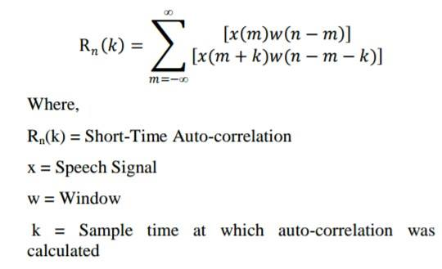
AUTO-correlation based method
The result of a correlation is a measure of similarity as a function of time lag between the beginnings of the two waveforms.
The pitch extraction process of a speech signal can be based on computing the short-time autocorrelation function of the speech signal.
For voiced segments of speech, the short-time autocorrelation function shows periodicity of the speech. Rn(k) decrease with k as the computation process continues.

Slide 8
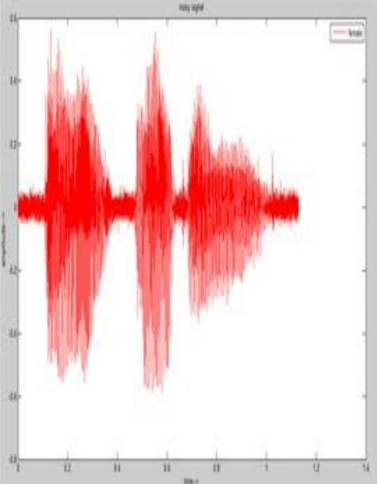
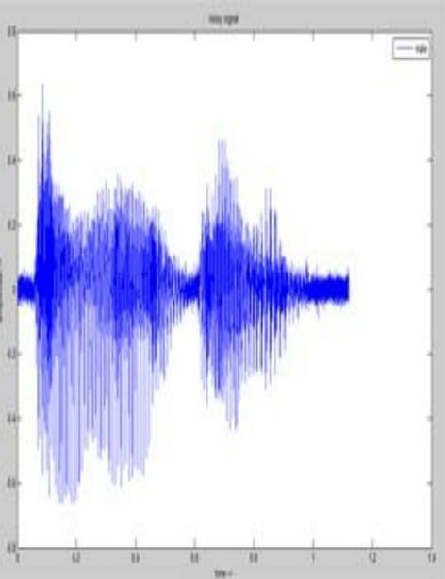
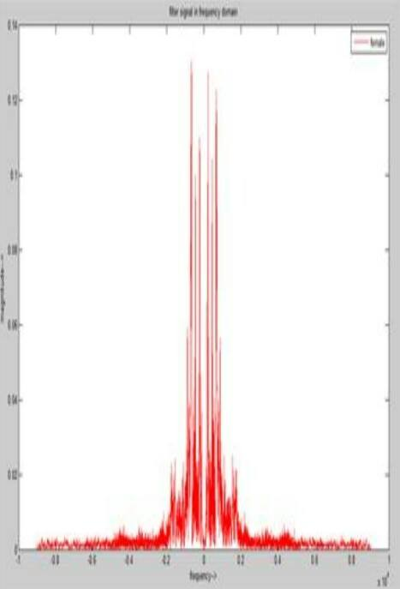
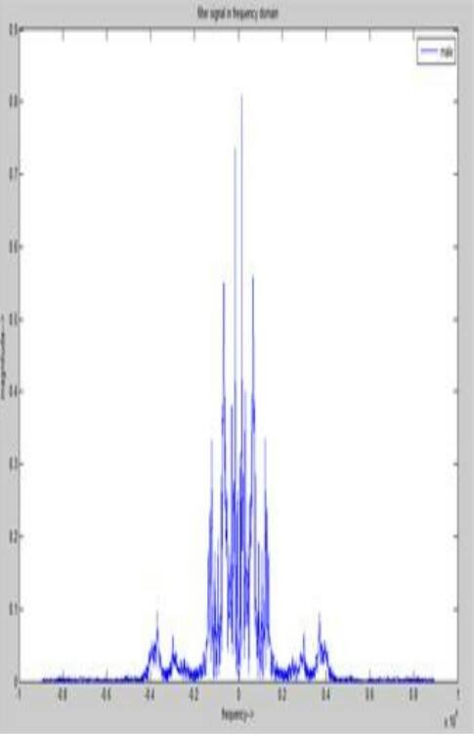
Simulation and results
These are the pitch analysis of a predefined
‘Oh My God’ spoken by a female and a male
speaker with no background sounds.
Time domain analysis were converted to frequency
analysis for better analysis and noise removal.
Noise was removed by application of a low-pass
filter.
Time domain analysis of female and male voice sample
Frequency domain plots of female and male voice sample
after application of filter

Slide 9
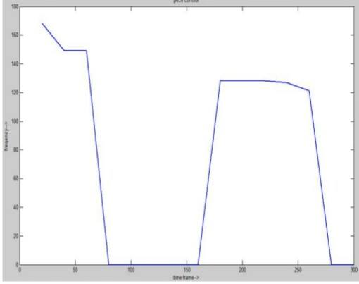
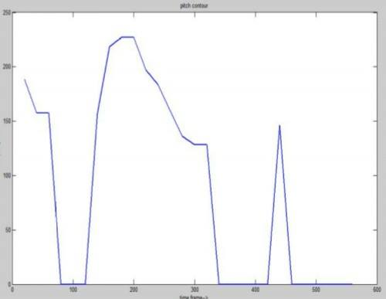
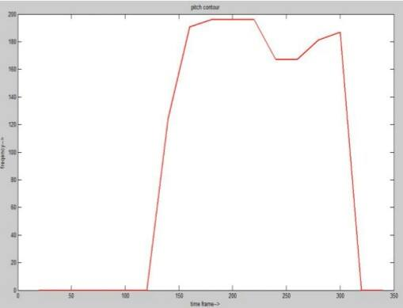
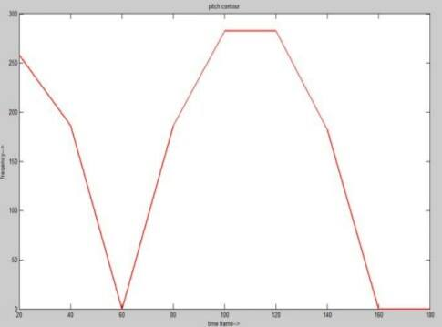
Pitch contour plot of male voice sample
Pitch contour plot of female voice sample

Slide 10
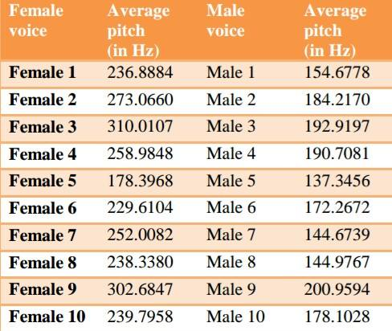
PITCH SAMPLES:
It was observed that the average pitch value for
female voice samples higher than that of male
voice samples.
Appropriate rectangular windows were designed
and used for the analysis.

Slide 11
Speech Enhancement
Automatic gender identification systems trained on clean speech under lab environments degrade in performance in real world conditions.
The additive environmental sounds such as noise and music, additionally there is a natural pause in human speech which is also considered as an additive environment sound.
Hence, before training a speech based system, speech enhancement pre-processing has to be done so that a good quality of speech can be extracted from speech recorded in a real world environment.

Slide 12

Signal to Noise Ratio
Used to find the quality of the input signal according to the background noise in the signal. Mathematically SNR can be written as –
$$SNR=\frac{Pspeech}{Pnoise}$$ where P is the power of input signal
$$P= \sqrt{1/T\sum_{n=0}^{T−1}{(x[n])^2}}$$
Where x[n] is the input signal and T is the time period of the signal.
To calculate SNR in MATLAB, we use the function ‘snrseg’.

Slide 13
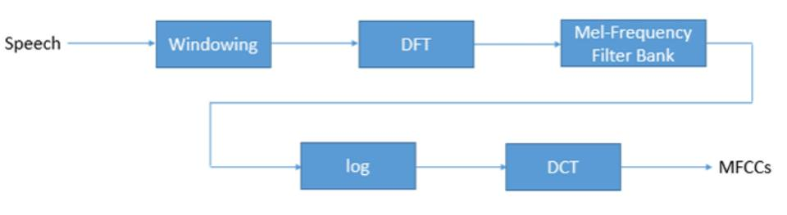
MEL FREQUENCY CEPSTRAL COFFICIENTS(MFCC):
Technique which tries to model the vocal tract filter in short time power spectrum

Slide 14
Windowing :-
Speech is windowed in 20-40ms frames.
More reliable computation for less speech duration.
If speech duration is more than 40ms then there will be changes in the signal.
DFT :-
Works in the similar way of Human Cochlea.
Power Spectrum of each frame is calculated.
Frequencies found in the signal are calculated.
Mel Frequency Filter Bank:-
Determine the energy levels of frequency regions.
At low frequencies Mel-Frequency filter bank is narrow and wider in the high frequencies .
All the information calibrated from periodogram found after the second step.

Slide 15
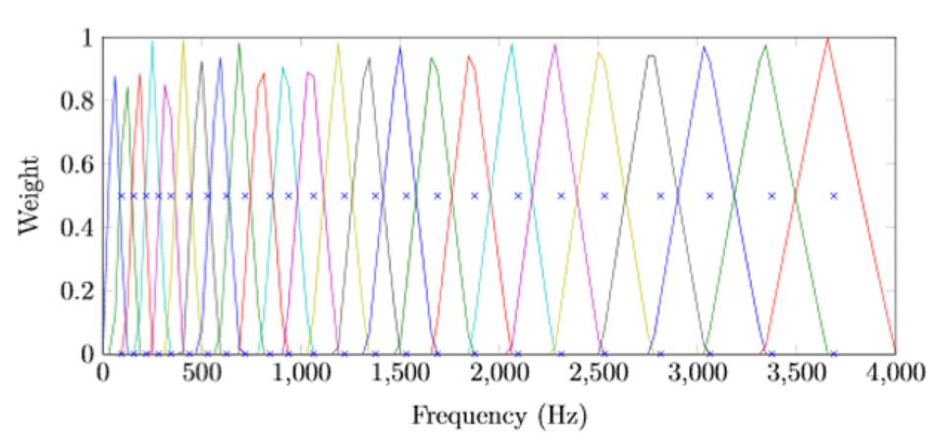
Log:-
Log is modulation of the energy levels.
Human ear system doesn’t follow a liner scale in terms of hearing.
By log human ear system cam be modelled better.
DCT:-
This is the final step to take DCT of the log filter bank energies.
This involves the decorrelation of the overlapped filter bank energies for better classification.

Slide 16


Spectral Subtraction
To find Power spectrum of Noise
In real world speech signal, the basic assumption is that there is a clean speech signal s[n] which is corrupted by some additive environmental sound y[n] so the real world speech signal can be written as –
x[n] = s[n] + y[n]
As s[n] and y[n] are more independent than the power spectrum of x[n] can be written as the sum power spectra of s[n] and y[n] -
| X( f )|^ 2 = | S( f )|^ 2 + |Y( f )| ^2
We can estimate |Y( f)|^ 2 by averaging the | X( f)|^ 2 over M frames –
Using the above two equations –

Slide 17
Gender Identification System
Speech
PreProcessing
Feature Extraction
Modelling
Model
Basic Block Diagram
Pitch Extraction Method
Pitch or fundamental frequency is considered to be a most basic discriminating factor between male and female voice.
A typical male adult has a fundamental frequency between 85Hz to 180Hz and an adult female has a fundamental frequency in the range of 165Hz to 225Hz.
Pitch determination algorithm is based on Sub harmonic (f/2, f/3, ..) to Harmonic (f, 2f, 3f, ..)ratio in the speech and uses log frequency scale and spectrum shifting technique to obtain the amplitude summation of harmonics and sub harmonics respectively.
The pitch of normal speech and the alternate cycle can be determined by comparing the amplitude ratio of harmonics and sub harmonics with the pitch perception result.

Slide 18
These systems find a thresholding value during the training.
When a new speech comes, its pitch value is compared to the threshold value, if the value is less than the threshold value than the speaker is male and if the value is greater than the threshold value than the speaker is female.
Usually the threshold value is set near 200Hz.
Pitch based models only work well for clean speech.
We also have models based on Acoustic Features using MFCC and other parameters using different classifiers.

Slide 19
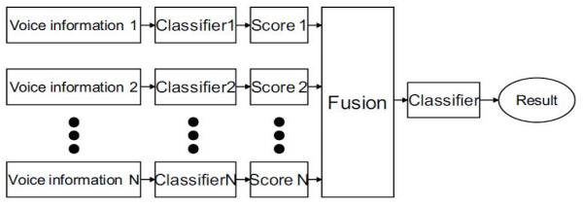
We can use acoustic features and pitch together to achieve higher accuracy in gender identification. A linear normalization method can be used to combine the score from acoustic analysis that used MFCC and score from pitch estimation.

Slide 20
References :
[1] Sarria-Paja, M., Falk, T.H., and O'Shaughnessy. D. (2013), "Whispered Speaker Verification and Gender Detection using Weighted Instantaneous Frequencies," Acoustics, Speech and Signal Processing (ICASSP), 2013 IEEE International Conference on, Vol., No., pp. 7209- 7213,26-31 May 2013
[2] Wiskon, L., Fellous, J.M., Kr"uger, N. and Malsburg, C. von der (1995), "Face Recognition and Gender Determination," in Int'l Workshop on Automatic Faceand Gesture Recognition,1 995, pp. 92-97.
[3] 8adawi, A., Mahfouz, M., Tadross, R. and Jantz, R. (2006), "Fingerprint-based gender classification," inInt 'I Conjon IPCV, 2006.
[4] Amayeh, G., Bebis, G. and Nicolescu, M. (2008), "Gender Classification from Handshape," in IEEE CVPR Workshops, 2008.
[5] Wunderlich, R. and Cavanagh, P. (2001), "Gender Differences in Adult Foot Shape: Implications for Shoe Design," Medicine and Science in Sports and Exercise, Vol. 33, No. 4, pp. 605-615, 2001.

Slide 21


